Slide 1
SharePoint 2007 Customizing Look and Feel
© 2008 Alexander Pajer

Slide 2
Agenda
Understanding the Page Model
Implementing Master Pages
Implementing Custom Style Sheets
Implementing Custom Themes

Slide 3
Understanding the Page Model

Slide 4
Master Page
Master Pages are used to provide the base layout by defining Content Placeholders
ASPX-Pages can display custom content or default to the masters content
Master Page
Custom ASPX
Content PlaceHolder
Custom Content

Slide 5
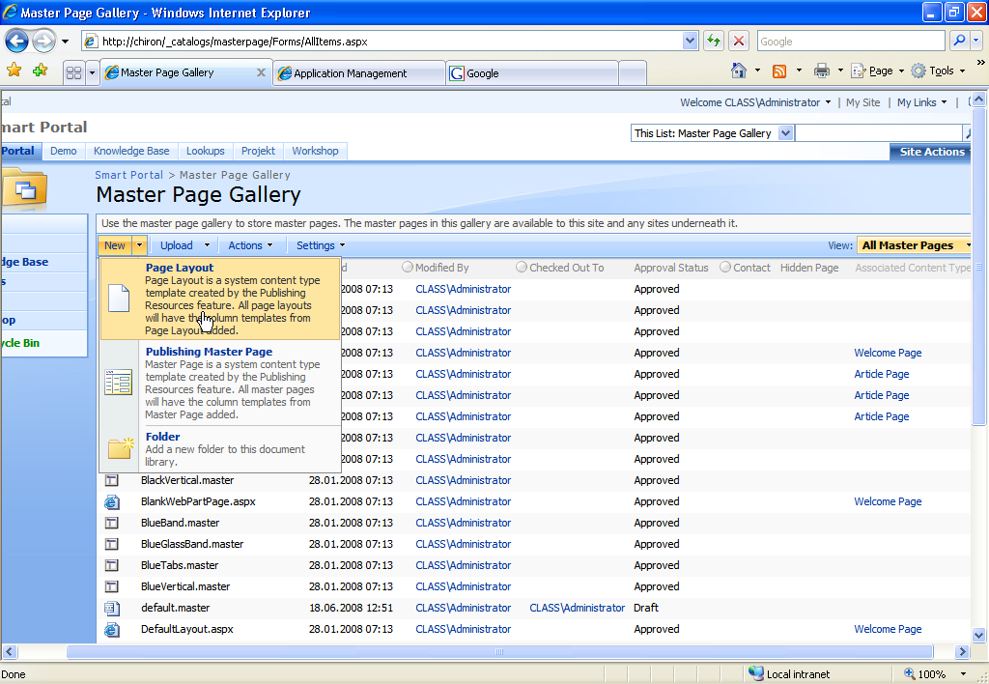
Master Page Gallery

Slide 6
Page Layouts
Page Layouts are implemented as ASPX-pages and define the layout of WebPart-Zones and SharePoint controls used in a page. They serve as a template for new pages.
They are stored in the File System or in the Master Page Gallery of the Site Collection

Slide 7
Page Rendering
Master Page
Content PlaceHolder
Resulting Page
Content PlaceHolder
Page Layout
Custom Content

Slide 8
Page Layout Model
Page Layouts use Content Types to determine the type of data that can be displayed.
Site Column
Start Date
ExpirationDate
Contact
...
Content Type
Page
Page Layout
Associate
Custom Content

Slide 9
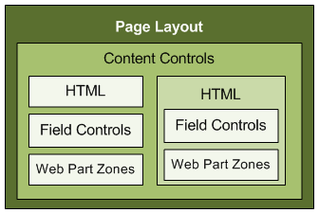
Field Control and Control Templates
Field Controls are ASP.NET 2.0 controls used for rendering and design time display
Control Templates seperate
data from presentation

Slide 10
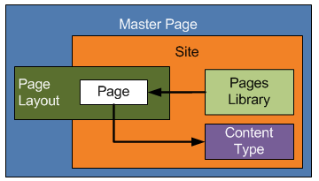
Pages
Pages are instances of Page Layouts and are stored in the Pages Library of the local site.

Slide 11
Application Pages
Application Pages are stored in ..\Template\Layouts and may contain INLINE CODE or code deployed to the GAC. They are implemented to extend functionality and are often integrated into the menus

Slide 12
Implementing Master Pages

Slide 13
Master Page Types
SharePoint knows 2 types of master pages which can be configured using Site Settings
Site Master
Applies to all Publishing Pages
System Master
Applies to classical SharePoint site display

Slide 14
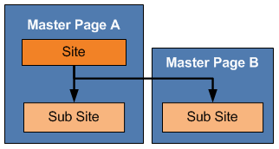
Master Page Inheritance
Master Pages can be applied on a site leve and are inherited down the hierachie

Slide 15
Elements of Master Pages 1/2
Master Directive
Registration of Controls
<%@ Master language="C#" %>
<%@ Register Tagprefix="SPSWC" Namespace="Microsoft.SharePoint.Portal.WebControls" Assembly="Microsoft.SharePoint.Portal, Version=12.0.0.0, Culture=neutral, PublicKeyToken=71e9bce111e9429c" %>
<%@ Register Tagprefix="SharePoint" Namespace="Microsoft.SharePoint.WebControls" Assembly="Microsoft.SharePoint, Version=12.0.0.0, Culture=neutral, PublicKeyToken=71e9bce111e9429c" %>

Slide 16
Elements of Master Pages 2/2
Web Part Manager
Persistis state of the page instance
Content Placeholder
Provides Content Zones for Page Layouts
<WebPartPages:SPWebPartManager runat="server"/>
<asp:ContentPlaceHolder id="PlaceHolderMain" runat="server" />

Slide 17
Required Content Placehoder 1/3
Name of Content Placeholder | Description
PlaceHolderLeftNavBarDataSource | Data source for the left navigation menu
PlaceHolderLeftNavBarTop | Top of the left navigation area
PlaceHolderMain | Page’s main content
PlaceHolderMiniConsole | A place to show page-level commands, for example, WIKI commands such as Edit Page, History, and Incoming Links
PlaceHolderNavSpacer | The width of the left navigation area
PlaceHolderPageDescription | Description of the page contents
PlaceHolderPageImage | Page icon in the upper left area of the page
PlaceHolderPageTitle | The page <Title> that is shown in the browser’s title bar
PlaceHolderSearchArea | Search box area
PlaceHolderSiteName | Site name
PlaceHolderTitleAreaClass | Additional styles in the page header
PlaceHolderTitleAreaSeparator | Shows shadows for the title area

Slide 18
Required Content Placehoder 2/3
Name of Content Placeholder | Description
PlaceHolderAdditionalPageHead | Additional content that needs to be within the <head> tag of the page, for example, references to script in style sheets
PlaceHolderBodyAreaClass | Additional body styles in the page header
PlaceHolderBodyLeftBorder | Border element for the main page body
PlaceHolderBodyRightMargin | Right margin of the main page body
PlaceHolderCalendarNavigator | Shows a date picker for navigating in a calendar when a calendar is visible on the page
PlaceHolderFormDigest | The “form digest” security control
PlaceHolderGlobalNavigation | The global navigation breadcrumb
PlaceHolderHorizontalNav | Top navigation menu for the page
PlaceHolderLeftActions | Bottom of the left navigation area
PlaceHolderLeftNavBar | Left navigation area
PlaceHolderLeftNavBarBorder | Border element on the left navigation bar

Slide 19
Required Content Placehoder 3/3
Name of Content Placeholder | Description
PlaceHolderTitleBreadcrumb | Main content breadcrumb area
PlaceHolderTitleInTitleArea | Page title shown immediately below the breadcrumb
PlaceHolderTitleLeftBorder | Left border of the title area
PlaceHolderTitleRightMargin | Right margin of the title area
PlaceHolderTopNavBar | Top navigation area
PlaceHolderUtilityContent | Extra content that needs to be at the bottom of the page
SPNavigation | Empty by default in Windows SharePoint Services. Can be used for additional page editing controls.
WSSDesignConsole | The page editing controls when the page is in Edit Page mode (after clicking Site Actions, then Edit Page)

Slide 20
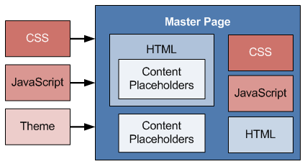
Designing a Master Page
Design of Master Pages is influenced by
CSS
Themes
JavaScript

Slide 21
CSS and Themes
Master Pages are skinned by the CORE.CSS which is located in „..\ TEMPLATE\LAYOUTS\1033\STYLES“
Custom CSS can be referenced
Themes are colletions of styles used together and have to be applied on each individual site
Themes are stored in „..\TEMPLATE\THEMES“

Slide 22
Storage of Master Pages
To store a Master Page you can choose between
Master Page Gallery of a site which refers to „/_Catalogs/Masterpage“ in SPD
Features Folder of a specific Feature
Master Pages deployed as Features can be provisioned to multible sites at once

Slide 23
Demo
Implementing a minimal Master Page

Slide 24
Deploying Master Pages as Feature

Slide 25
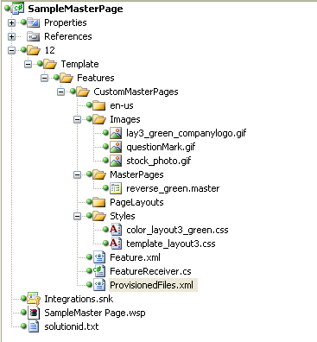
Deployment Structure

Slide 26
Feature.xml
<Feature Id="5FEE8E5B-B94A-467d-9EA9-BDC0269B719E"
Title="Custom Master"
Description="Custom Master Sample"
Version="12.0.0.0"
Scope="Site"
Hidden="False"
ReceiverAssembly="SampleMasterPage, Version=1.0.0.0, Culture=neutral, PublicKeyToken=d89d8b53939cdc55"
ReceiverClass ="Integrations.CustomMasterReceiver"
DefaultResourceFile="core"
xmlns="http://schemas.microsoft.com/sharepoint/">
<ElementManifests>
<ElementManifest Location="ProvisionedFiles.xml"/>
</ElementManifests>
</Feature>

Slide 27
Elements.xml 1/2
<?xml version="1.0" encoding="utf-8"?>
<Elements xmlns="http://schemas.microsoft.com/sharepoint/">
<Module Name="CustomMasterPages" Url="_catalogs/masterpage" Path="MasterPages" RootWebOnly="TRUE">
<!--the MasterPage file that you have to put in the CustomMasterPage/MasterPages folder-->
<File Url="reverse_green.master" Type="GhostableInLibrary">
<Property Name="ContentType" Value="Reverse Master" />
<!--MasterPage Description-->
<Property Name="MasterPageDescription" Value="Reverse Sample Master" />
</File>
</Module>

Slide 28
Elements.xml 2/2
<!-- The place where we can add the registry info of the images used in the MasterPage-->
<Module Name="Images" Url="Style Library/Images" Path="Images" RootWebOnly="TRUE">
<File Url="lay3_green_companylogo.gif" Name="lay3_green_companylogo.gif" Type="GhostableInLibrary"/>
<File Url="questionMark.gif" Name="questionMark.gif" Type="GhostableInLibrary"/>
<File Url="stock_photo.gif" Name="stock_photo.gif" Type="GhostableInLibrary"/>
</Module>
<!-- Styles, the name of the css file located in the CustomMasterPage\styles folder-->
<Module Name="Styles" Url="Style Library" Path="Styles" RootWebOnly="TRUE">
<File Url="color_layout3_green.css" Type="GhostableInLibrary" />
<File Url="template_layout3.css" Type="GhostableInLibrary" />
<File Url="HideNav.css" Type="GhostableInLibrary" />
</Module>
</Elements>

Slide 29
Activating Custom Master Page
using Microsoft.SharePoint;
namespace Integrations
{
public class CustomMasterReceiver : SPFeatureReceiver
{
public override void FeatureActivated(SPFeatureReceiverProperties properties)
{
SPWeb web = ((SPSite) properties.Feature.Parent).RootWeb;
web.MasterUrl = "/_catalogs/masterpage/default.master";
web.CustomMasterUrl = "/_catalogs/masterpage/reverse_green.master";
web.Update();
}
public override void FeatureDeactivating(SPFeatureReceiverProperties properties)
{
SPWeb web = ((SPSite) properties.Feature.Parent).RootWeb;
web.MasterUrl = "/_catalogs/masterpage/default.master";
web.CustomMasterUrl = "/_catalogs/masterpage/default.master";
web.AlternateCssUrl = string.Empty;
web.Update();
}
}
}

Slide 30
Demo
Deploying a Master Page as a Feature

Slide 31
Style Sheets & Themes

Slide 32
Core.CSS
SharePoints main CSS, Core.CSS is located in ..\TEMPLATE\LAYOUTS\1033\STYLES
All other styles inherit from Core.CSS
Classes of Core.CSS are documented in http://www.heathersolomon.com/content/ sp07cssreference.htm

Slide 33
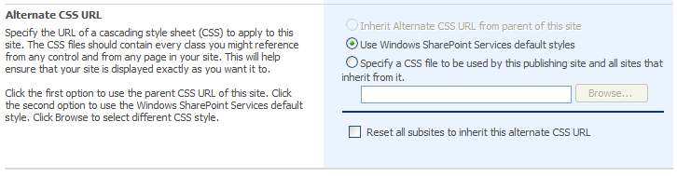
Custom CSS
Custom CSS are registered in the Master-Page using
or using SiteSettings – Master Page
<SharePoint:CssRegistration name=”<% $SPUrl:~SiteCollection/Style Library/custom.css%>” runat=”server”/>

Slide 34
Implementing Custom Styles
Sample: Hiding Navigation
div.ms-quicklaunch table.ms-recyclebin
{
display: none;
}
#ctl00_PlaceHolderLeftNavBar_idNavLinkViewAll
{
Visibility:hidden;
}
.ms-navframe
{
display:none;
}

Slide 35
Custom Style Feature
<Feature Id="028889DD-D29B-4612-BA02-85A24500F3FE"
Title="Hide Navigation"
Description="Hides the navigation of the site"
Version="12.0.0.0"
Scope="Site"
Hidden="False"
ReceiverAssembly="HideNavigation, Version=1.0.0.0, Culture=neutral, PublicKeyToken=80c6eff561f928ee"
ReceiverClass ="Integrations.NavigationReceiver"
DefaultResourceFile="core"
xmlns="http://schemas.microsoft.com/sharepoint/">
<ElementManifests>
<ElementManifest Location="ProvisionedFiles.xml"/>
</ElementManifests>
</Feature>

Slide 36
Custom Style Elements
MOSS – Deploy to Styles Library
<?xml version="1.0" encoding="utf-8"?>
<Elements xmlns="http://schemas.microsoft.com/sharepoint/">
<!-- Styles, the name of the css file located in the CustomMasterPage\styles folder-->
<Module Name="Styles" Url="Style Library" Path="Styles" RootWebOnly="TRUE">
<File Url="HideNav.css" Type="GhostableInLibrary" />
</Module>
</Elements>

Slide 37
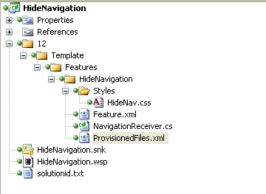
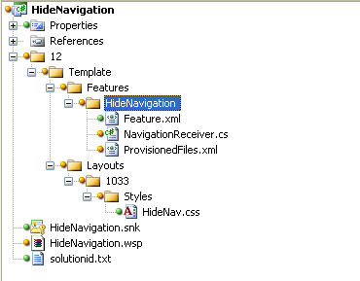
Deployment Structure
WSS
MOSS

Slide 38
Auto Applying Styles
public class NavigationReceiver : SPFeatureReceiver
{
public override void FeatureActivated(SPFeatureReceiverProperties properties)
{
SPSite site = properties.Feature.Parent as SPSite;
foreach (SPWeb web in site.AllWebs)
{
if (web.Title!="Knowledge Base")
{
web.AlternateCssUrl = "_layouts/1033/styles/hidenav.css";
web.Update();
}
}
}
public override void FeatureDeactivating(SPFeatureReceiverProperties properties)
{
SPSite site = properties.Feature.Parent as SPSite;
foreach (SPWeb web in site.AllWebs)
{
web.AlternateCssUrl = string.Empty;
web.Update();
}
}
}

Slide 39
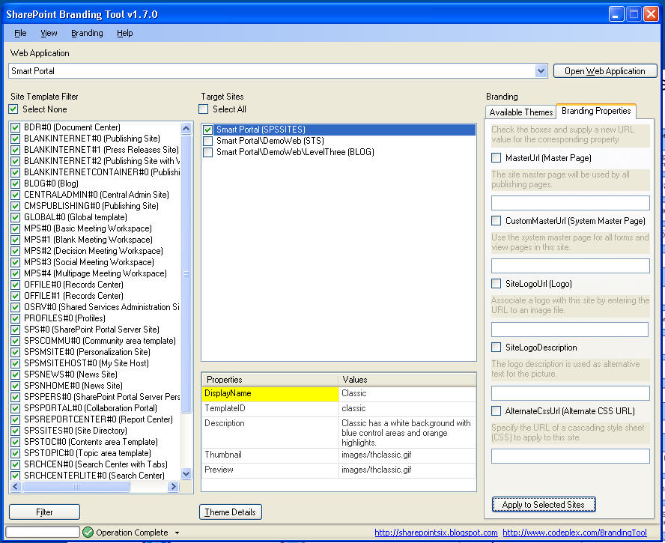
SharePoint Branding Tool
Use SharePoint Branding Tool to test your Styles

Slide 40
Demo
Implementing a Custom Master Page with CSS

Slide 41
Implementing Themes

Slide 42
SharePoint Themes Basics
A theme is a collection of CSS-Files and graphical ressources
Theme Setup Information is maintained in THEME.INF
Themes are stored in a ..\TEMPLATE\THEMES subfolder

Slide 43
Elements of a Theme
A SharePoint Theme consists of the following elements
File | Usage
theme.css | Main CSS file that defines most of the look and feel
mossExtensions.css | MOSS specific extensions
*.css | Custom CSS
theme.inf | The Theme registration file
*.gif, *.png | Images used in your theme

Slide 44
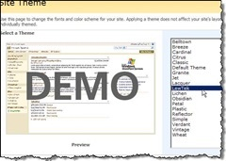
Theme Preview Image
A Theme Preview Image in the size of 375 x 231 pixles with the Name of the Theme can be saved to ..\TEMPLATE\IMAGES

Slide 45
Theme Registration
Themes have to be registered in SPTHEMES.xml which is located in ...\TEMPLATE\LAYOUTS\1033
<Templates>
<TemplateID>MyCustomTheme</TemplateID>
<DisplayName>MyCustomTheme</DisplayName>
<Description>My custom SharePoint Theme</Description>
<Thumbnail>images/mythumb.gif</Thumbnail>
<Preview>images/mypreview.gif</Preview>
</Templates>

Slide 46
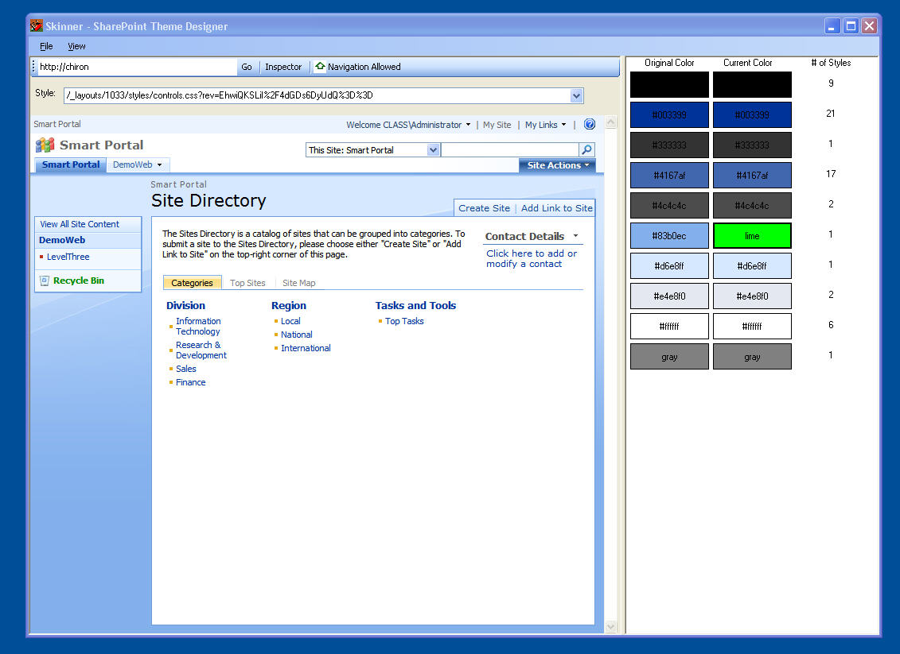
SharePoint Skinner
Use SharePoint Skinner to create custom Themes

Slide 47
THANK YOU!!
ALEXANDER.PAJER@INTEGRATIONS.AT

